Slide 1
Capstone Project
Under guidance of
KOPPERUNDEVI N-Scope

Slide 2
Fabric And Production Defect Detection In The Apparel Industry Using Machine Learning Algorithms
Team members:
Veerendranath A-19BCI0238
Sunil ch-19BCE2554

Slide 3
ABSTRACT:
Automated quality guarantee of textile fabric materials is one of the most important and demanding computer vision tasks in textile smart manufacturing. This survey presents a thorough overview of algorithms for fabric defect detection. First, this review briefly introduces the importance and inevitability of fabric defect detection towards the era of manufacturing of artificial intelligence.Second, defect detection methods are categorized into traditional algorithms and learning-based algorithms, and traditional algorithms are further categorized into statistical, structural, spectral, and model-based algorithms.
The learning-based algorithms are further divided into conventional machine learning algorithms and deep learning algorithms which are very popular recently. A systematic literature review on these methods is present. Thirdly, the deployments of fabric defect detection algorithms are discussed in this study. This paper provides a reference for researchers and engineers on fabric defect detection in textile manufacturing.

Slide 4
Introduction
Industrial artificial intelligence is typical cross-disciplinary, which combines knowledge of mechanical, data science, network, communication, information security, and other disciplines, and it aims to use artificial intelligence algorithms to solve industrial problems and improve the efficiency and security of manufacturingTowards industry 4.0, the textile manufacturing industry also needs to find its own way to adapt the manufacturing process.Textile manufacturing is a large-scale and complicated industry.The textile manufacturing process consists of a series of complex and orderly processes, mainly including spinning, weaving, dyeing, printing and finishing, and garments manufacturing.The stability and quality of the textile fabric produced by the whole production line are crucial to any enterprise.

Slide 5
Problem defination
The work failed to develop a complex ensemble model for fusing the data.
The required computational time is high.
The work failed to get accuracy of filtered image.
We need to improve the accuracy of segmentation.
Failed to prove effectiveness of segmentation system by implementing various measures.
Failed to improve dimensionality.
Reduced the quality of the image.

Slide 6
EXISTING METHOD:
The new filter is an edge-preserving filter especially when images are polluted by mixed noise containing Gaussian noise, Poisson noise, and impulse noise.
The structural features are obtained from multi resolution analyses which are used to discriminate the structures as borders, dots and streaks.
On the other side, the textural features computed by LBP operators are used to discriminate the local variation of colours, the pigment network etc.
Later, these features are fused in multiple combinations to investigate the influence of each combination in the performance of detection.
Manually checking process.Svm algorithm.

Slide 7
Proposed method:
Fabric defects correspond to defects on the surface of the textile fabric.
Most fabric defects are caused by machine or process faults and malfunctions.
The existence of fabric defects greatly reduces the sale and use of textiles. Textile manufacturing companies need to upgrade equipment and technology to maintain growth and competitiveness.
The sensing, storage, and computing capabilities of automated fabric detection systems based on computer vision will continue to improve. The development of hardware and algorithms will greatly affect the accuracy of detection and the ease of deployment.
The algorithms used were converting to grey scale image, sharpening filter, median filter, smooth filter, binary mask, RGB extraction, and histogram and Sobel operator.
The RGB values of the images are extracted before converting it into a Gray scale image.
Sharpening filter is applied to the Gray scale image in order to sharpen the details of the infected region. Advanced feature will be added such as Entropy,kwotsis,Skewness etc..
We using CNN algorithm to detect damage parts.

Slide 8
LITERATURE SURVEY
A Fabric Defect Detection Method Based on Deep Learning :
QIANG LIU , CHUAN WANG , YUSHENG LI, MINGWANG GAO, AND JINGAO LI School of Mechanical Engineering, Shandong University of Technology, Zibo 255049, Chin
The model proposed in this paper has been bettered for small cloth disfigurement areas that are close to the background shape, and has overcome the low effectiveness of the traditional homemade findings. Compared with the original YOLOv4, the bettered YOLOv4 upgrades chart by 6%, while FPS only diminishments 2. Grounded on expansive exploration and a detailed analysis of fabric blights, our network model is the most suitable for fabric disfigurement discovery.The model proposed in this paper has high precision and excellent real-time performance, and can be effectively applied for defect detections in industrial fabrics.

Slide 9
A Universal and Adaptive Fabric Defect Detection Algorithm Based on Sparse Dictionary Learning
Authors: XUEJUAN KANG AND ERHU ZHANG.YEAR:December 22, 2020.
In this paper, we proposed a universal meager wordbook Learning algorithm for detecting colorful blights of different fabric texture. It depends on the setting of two parametersthe dictionary infinitesimal number K and the image block size m ∗ n. These two parameters are nearly related to background, texture characteristics and lightness of the fabric.The algorithm shows good universality in the experimental results and has wide operation value in the factual fabric disfigurement discovery.

Slide 10
FLOW DIAGRAM
Proposed system
PREPROCESSING
(RGBTOGRAY
HISTOGRAM EQUALISATION)
BROWSE DATASET
GUI
Image segmentation
(Active contour)
Trained dataset
(Predict)
Classification
(CNN)
VOICE NOTES OUTPUT
Decision result
(DAMAGES or GOOD OR AVERAGE)

Slide 11
MODULES
Graphical user interfaces (GUIs), also known as apps, provide point-and-click control of your software applications, eliminating the need for others to learn a language or type commands in order to run the application.
You can share apps both for use within MATLAB.
A user interface (UI) is a graphical display in one or more windows containing controls, called components, that enable a user to perform interactive tasks.
The user does not have to create a script or type commands at the command line to accomplish the tasks.
Unlike coding programs to accomplish tasks, the user does not need to understand the details of how the tasks are performed.

Slide 12
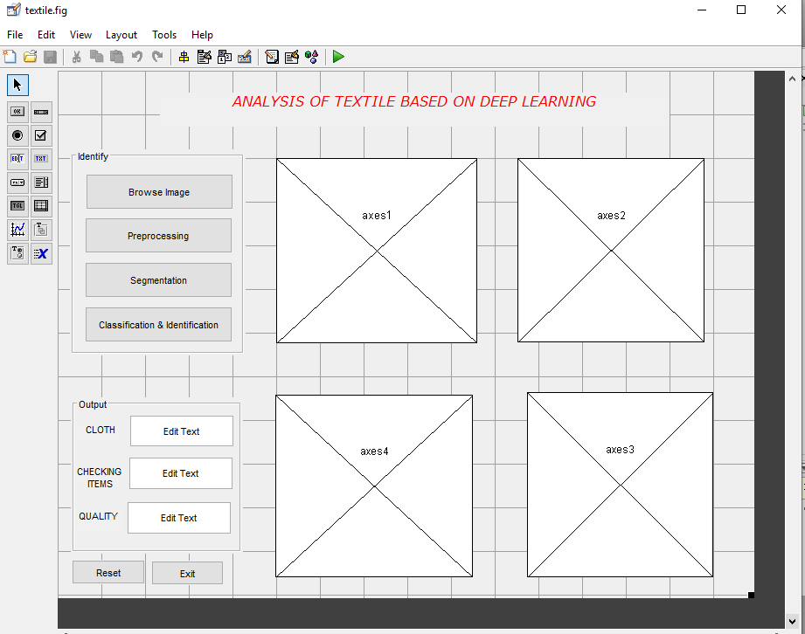
GUI

Slide 13
Histogram of oriented gradients
The histogram of oriented gradients (HOG) is a feature descriptor used in computer vision and image processing for the purpose of object detection.
The technique counts occurrences of gradient orientation in localized portions of an image.
This method is similar to that of edge orientation histograms, scale-invariant feature transform descriptors, and shape contexts, but differs in that it is computed on a dense grid of uniformly spaced cells and uses overlapping local contrast normalization for improved accuracy.

Slide 14
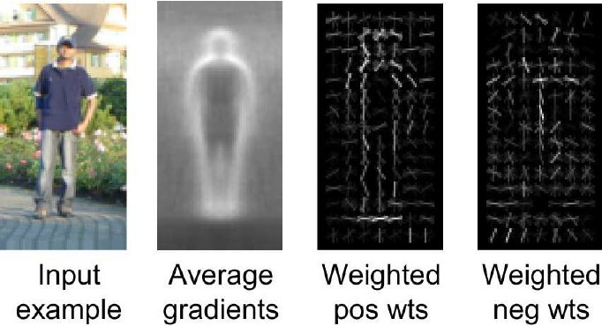

Slide 15
ACM
Active contour is a segmentation method that uses energy forces and constraints to separate the pixels of interest from a picture for further processing and analysis.
Active contour is defined as an active model for the segmentation process. Contours are the boundaries that define the region of interest in an image. A contour is a collection of points that have been interpolated. The interpolation procedure might be linear, splines, or polynomial, depending on how the curve in the image is described.
The contour segmentation constraints for a certain image are determined by the needs. The desired shape is obtained by defining the energy function. A collection of points that locate a contour is used to describe contour deformation. This shape corresponds to the desired image contour, which was defined by minimizing the energy function.

Slide 16
CNN
A Convolutional neural network (CNN) is a neural network that has one or more convolutional layers and are used mainly for image processing, classification, segmentation and also for other auto correlated data.
The rule of thumb is to start with a simple CNN that has one hidden layer with around 10 kernels with dimension 3 and one max pooling layer.
Based on our results, controlling the trade-off between accuracy and training speed, we can slowly increase the number of kernels and add new layers.
An activation must be added to each layer. Backpropagation tool first calculates the error between the result of reference and the given sample, and then uses the descent to adjust the weight mesh and offset

Slide 17
Unlike earlier computer vision algorithms, convolutional neural networks can operate directly on a raw image and don't need any preprocessing. The usage of convolutional layers in a convolutional neural network mirrors the structure of the human visual cortex, where a series of layers reuse an incoming image and identify progressive more complex features.

Slide 18
SOFTWARE REQUIREMENTS
Matlab 2021(A)
MATLAB is a scientific programming language and provides strong mathematical and numerical support for the implementation of advanced algorithms. It is for this reason that MATLAB is widely used by the image processing and computer vision community. New algorithms are very likely to be implemented first in MATLAB, indeed they may only be available in MATLAB.

Slide 19
SYSTEM REQUIREMENTS:
Windows 7 (or) higher
64 bit operating system
Disk Space
2 GB for MATLAB only,
4–8 GB for a typical installation.
Minimum 2GB RAM needed
No specific graphic cards required

Slide 20
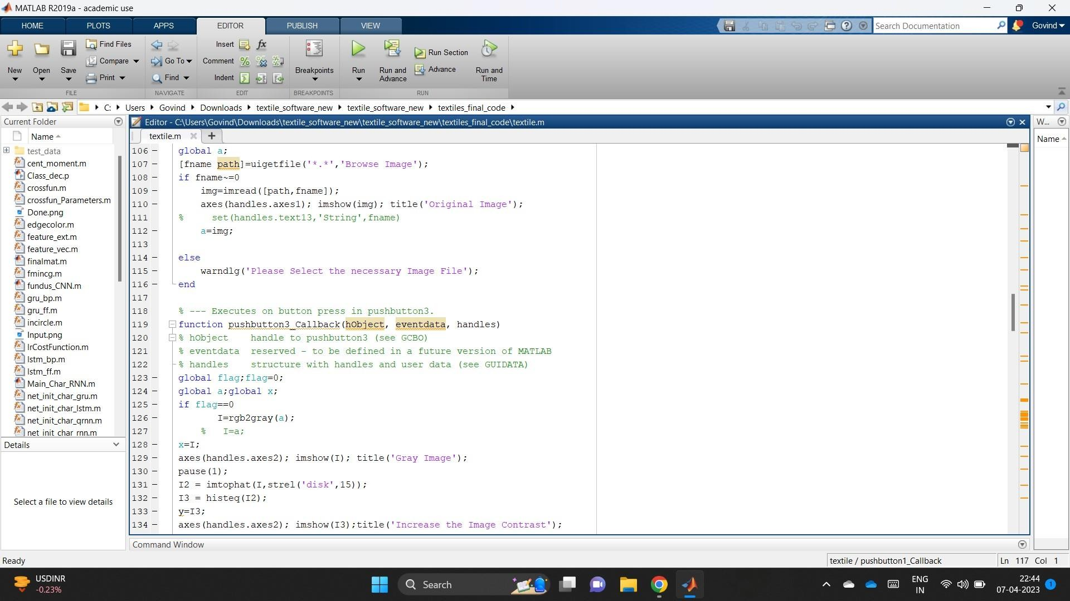
Results and Discussion code snippet used for the fabric defect.

Slide 21
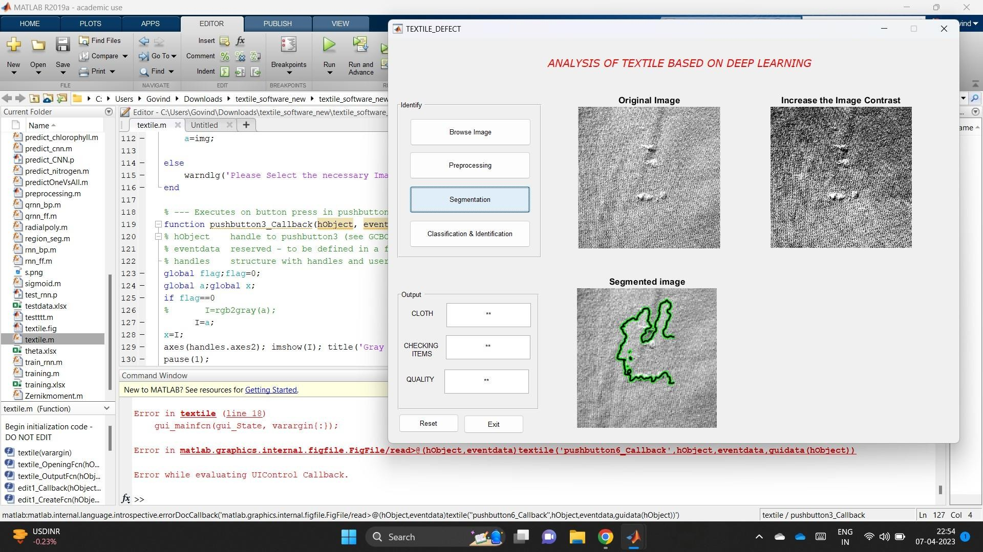
segmentation(we use Active Contour Method to identify the boundaries of the damaged segment in the image)

Slide 22
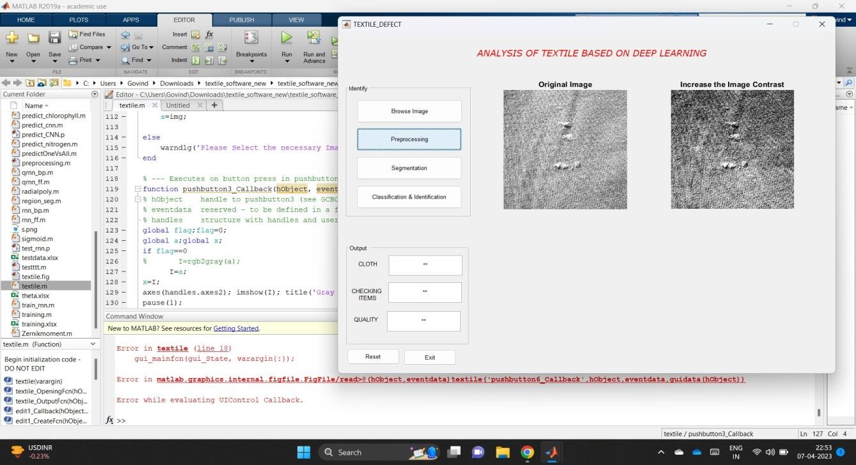
preprocessing increase the image contrast(after we take the input, it is converted to gray-scale image)

Slide 23
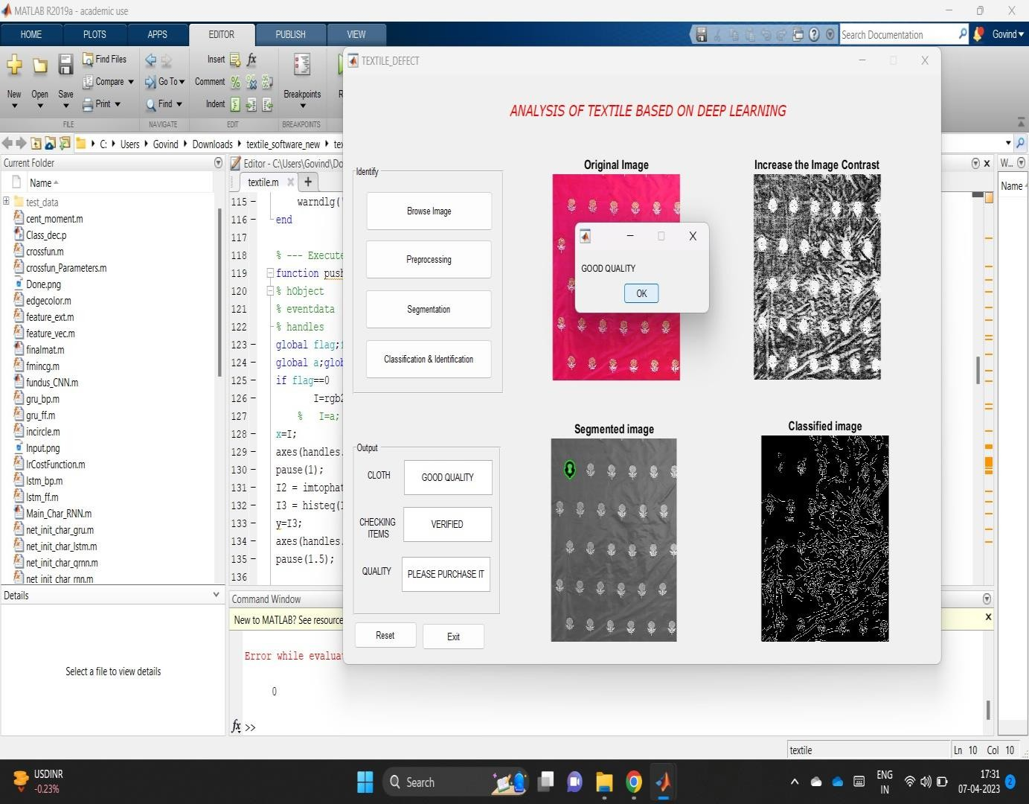
classification and identification(we have used CNN method to classify and identify whether to purchase the cloth or not based on the result)

Slide 24
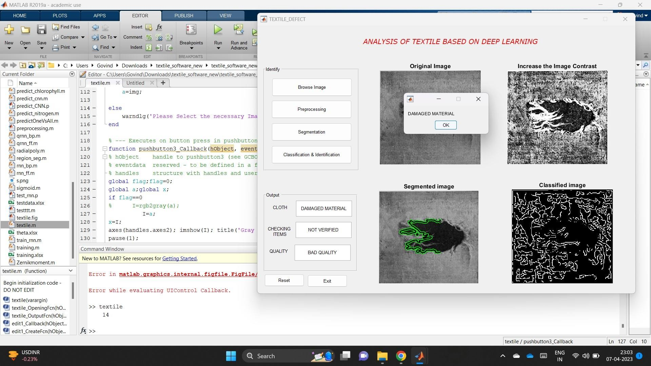
it shows the type of the cloth as well as quality of the product used in below as
(DAMAGED MATERIAL)

Slide 25
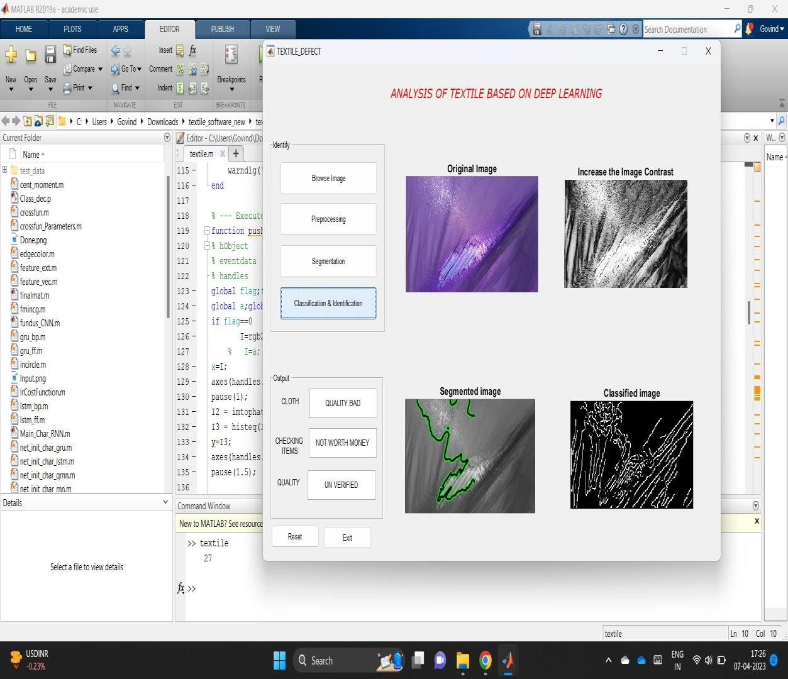
This is an example of the Bad quality Material and at the end it says “Not worth buying”.

Slide 26
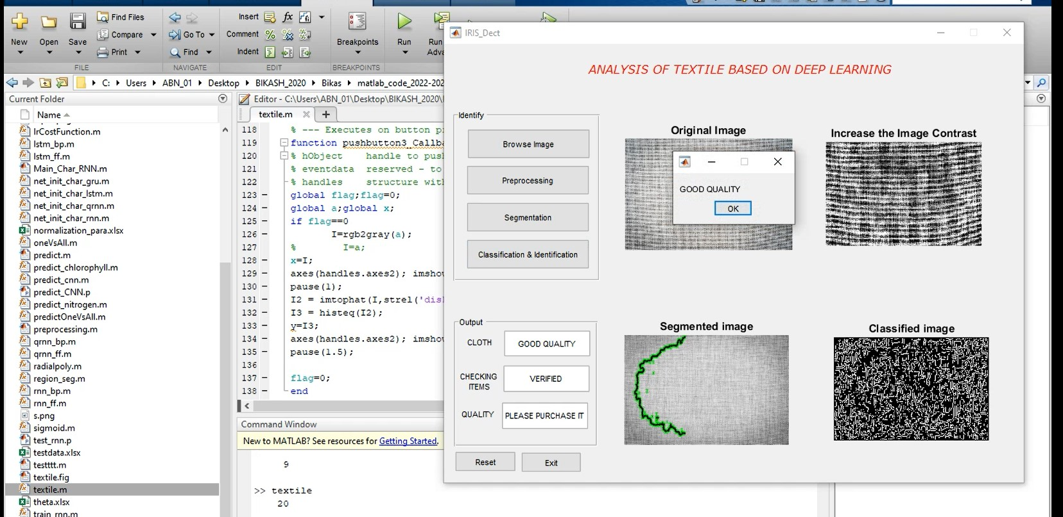
It is example for the good quality of the used fabric product as (GOOD QUALITY)

Slide 27
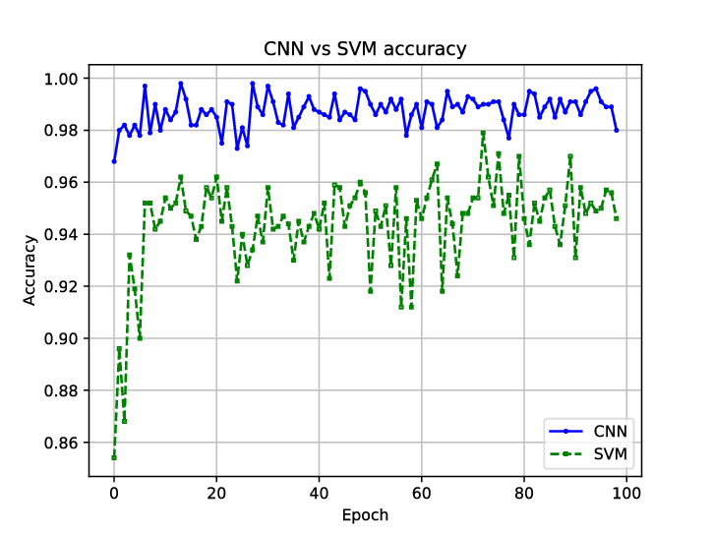
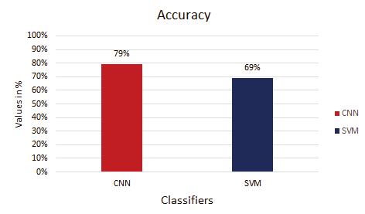
Discussion(Comparative Analysis) CNN VS SVM CNN is primarily a good candidate for Image recognition. You could definitely use CNN for sequence data, but they shine in going to through huge amount of image and finding non-linear correlations. SVM are margin classifier and support different kernels to perform these classificiation. Where SVM suffer is predicting the class labels when the size of the class labels is huge.Comparative analysis of validation accuracy for CNN and SVM Analysis of graph: In terms of accuracy CNN has the max accuracy of 79% than SVM, as CNN works better for image dataset. The comparative analysis for Precision , F1 score and Recall shown in Table 1 for CNN and SVM classifier. It is evident that the CNN classifier is more precise, has more recall ability and more f1 score than SVM

Slide 28
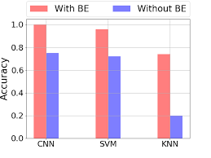
CNN VS KNN : The model with CNN and KNN, i got train accuracy of CNN is 99% and Test accuarcy is 98% and KNN train accuarcy is 98% and Test accuracy 98%.In KNN, output completely relies on nearest neighbors, which may or may not be good choice. Also it is sensitive to distance metrics. On the other hand, CNN extract the features from the input data. Which are very helpful for making analysis. And recent success in the CNN specially wavelet for the audio application, I will prefer to go with CNN. Considering your data-size, CNN is good option here.

Slide 29
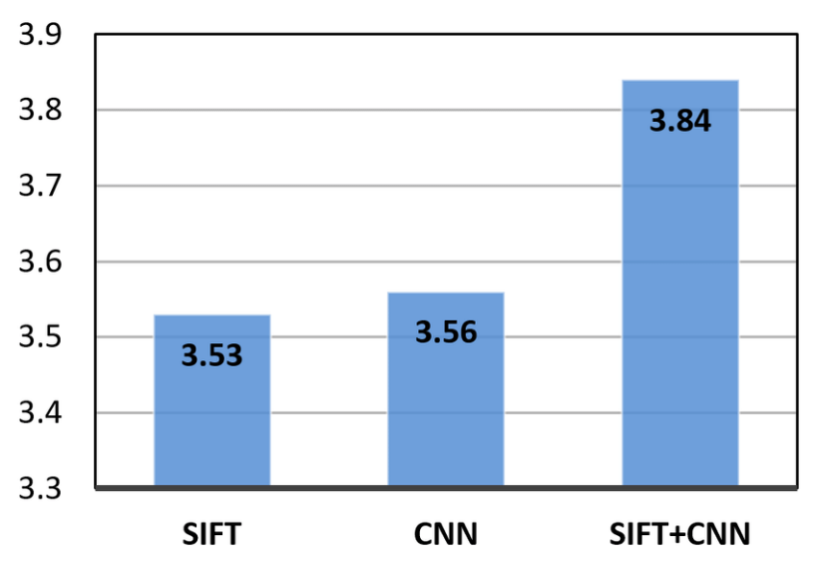
CNN VS SIFT: Based on first order gradients.Course, that is, it is evaluated around scale invariant feature points obtained using the difference of gaussian (DoG) key point detector. There is a dense variant known as the dense-SIFT. CNNs are trainable feature detectors which makes them highly adaptive. That is why they can achieve high accuracy levels in most applications such as image recognition. They can be trained end-to-end.. They can learn low-level features similar to SIFT and HOG features from training examples alone, that is amazing. Thus one can minimize feature engineering when it comes to using CNNs. Thus SIFT and HOG features are low-level features which don't make use of hierarchical layer-wise representation learning while the CNN is a hierarchical deep learning model which is able to model data at more and more abstract representations.

Slide 30
The accuracy of CNN with LSTM comes out to be 69%, RNN comes out to be 78% and the accuracy of CNN is 95 % .We conclude with our results that CNN performs better than CNN with LSTM and RNN. In future we would try to combine reinforcement learning with our solution and further try to improve the prediction accuracy in real-time environment.

Slide 31
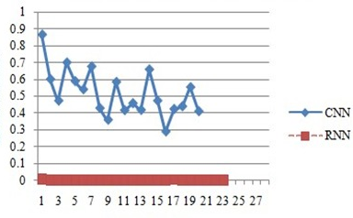
CNN VS RNN: RNNs are suitable for sequential/temporal data. CNNs are suitable for spatial data, e.g. images. Both have worked wonderfully well for the respective types of data they are suitable for. The key idea behind both models is same: introduce sparsity by reusing the same weights and neurons over different parts of image (in CNN) and over time (in RNN).

Slide 32
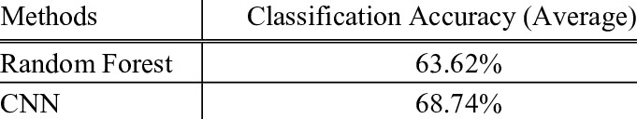
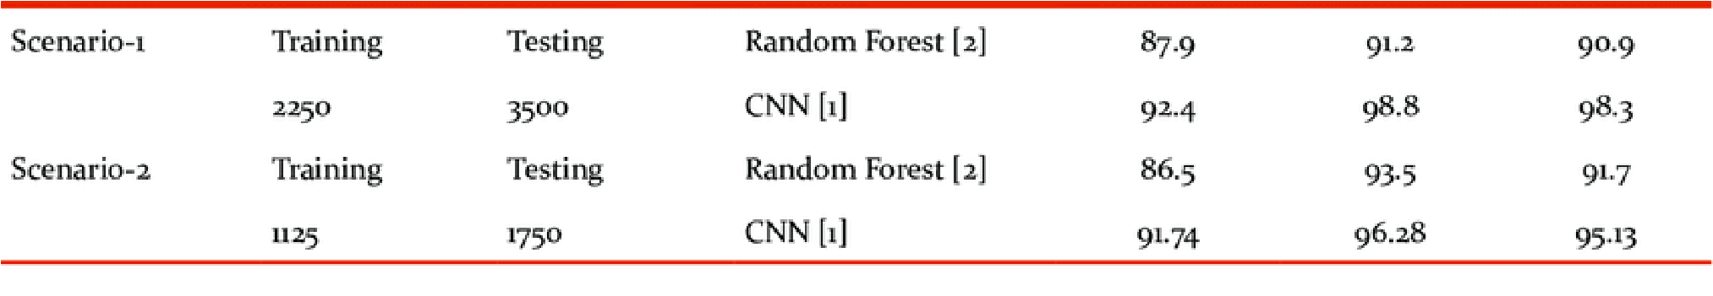
CNN VS RANDOM FOREST
Random Forest,despite their current high visibility in the media, not always need to be the first choice in selecting a machine learning methodology. CNN not only achieve (at least) similarly good performance results in practical application in many areas, they also have some advantages compared to Neural Networks in specific cases. This includes their robustness as well as benefits in cost and time. They are particularly advantageous in terms of interpretability. If we were faced with the choice of taking a model with 91% accuracy that we understand or a model with 93% accuracy that we don't currently understand.
table comparison of random forest accuracy

Slide 33
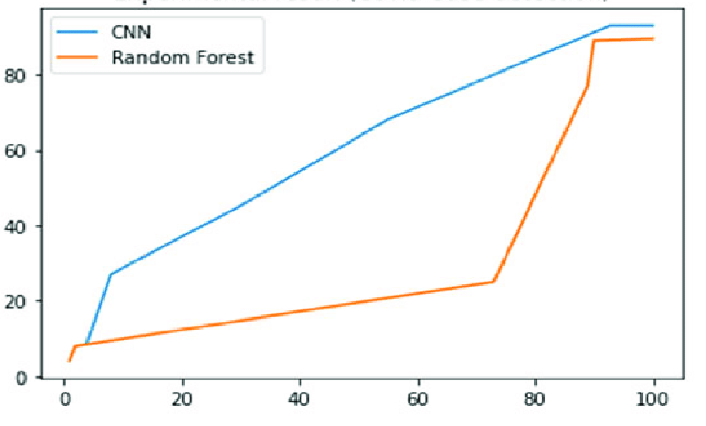
table comparison of testing in random forest with different accuracy
graph representation of random forest vs CNN

Slide 34
FUTURE SCOPE
The use of machine learning algorithms for fabric and defect detection has shown promising results. Using Convolutional Neural Networks (CNNs) to segment fabrics and detect defects has been able to effectively identify and classify defects with high precision.
The active contour method for defect detection, which uses an energy minimization technique, has also been effective in segmenting fabrics and detecting defects.
In the future, further research can be done to improve the accuracy of these methods. For example, combining CNNs with other neural networks such as recurrent neural networks or generative adversarial networks could help improve the performance of fabric and defect detection. Additionally, research in developing new novel machine learning algorithms specifically designed for fabric and defect detection could further increase the accuracy of these systems.
Overall, the use of machine learning algorithms for fabric and defect detection is a promising area of research with potential applications in many industries. With further development and optimization, these algorithms could lead to significant improvements in efficiency and quality when it comes to fabric and defect detection.

Slide 35
Conclusion:
The conclusion of this project is that using machine learning algorithms such as CNN and active contour method can effectively detect fabric defects in images. The detection of fabric productional defects in the apparel industry has been greatly enhanced through the application of machine learning algorithms. These algorithms, coupled with advanced image analysis techniques, provide a powerful and automated solution for defect detection. By leveraging large datasets and pattern recognition capabilities, machine learning algorithms offer improved accuracy, efficiency, and consistency compared to traditional manual inspection methods.
The integration of machine learning algorithms into the fabric production process has several benefits. It enables faster defect identification, leading to timely mitigation and reduced production costs. Additionally, automated defect detection ensures high product quality, minimizing customer dissatisfaction and returns. The real-time monitoring capabilities of machine learning algorithms facilitate proactive quality control and enable prompt action in the event of detected defects.
By harnessing the power of machine learning algorithms, the apparel industry can achieve higher productivity, optimized resource utilization, and enhanced customer satisfaction. The continuous improvement and adaptation of these algorithms further contribute to ongoing advancements in defect detection, ensuring a reliable and efficient quality control process.Overall, the utilization of machine learning algorithms for fabric productional defect detection has revolutionized the apparel industry, providing a transformative solution that streamlines operations, improves efficiency, and upholds product quality standards.

Slide 36
References:
[1] C. Mera, M. Orozco-Alzate, J. Branch, and D. Mery, ‘‘Automatic visual inspection: An approach with multi-instance learning,’’ Comput. Ind., vol. 83, pp. 46–54, Dec. 2016.
[2] A. Kumar, ‘‘Computer-vision-based fabric defect detection: A survey,’’ IEEE Trans. Ind. Electron., vol. 55, no. 1, pp. 348–363, Jan. 2008.
[3] P. M. Mahajan, S. R. Kolhe, and P. M. Patil, ‘‘A review of automatic fabric defect detection techniques,’’ Adv. Comput. Res., vol. 1, no. 2, pp. 18–29, Jan. 2009.
[4] X. Zheng, H. Wang, J. Chen, Y. Kong, and S. Zheng, ‘‘A generic semisupervised deep learning-based approach for automated surface inspection,’’ IEEE Access, vol. 8, pp. 114088–114099, Jun. 2020.
[5] W. Ouyang, B. Xu, J. Hou, and X. Yuan, ‘‘Fabric defect detection using activation layer embedded convolutional neural network,’’ IEEE Access, vol. 7, pp. 70130–70140, Apr. 2019.
[6] S. H. Hajimowlana, R. Muscedere, G. A. Jullien, and J. W. Roberts, “1D autoregressive modeling for defect detection in web inspection systems,” in 1998 Midwest Symposium on Circuits and Systems (Cat. No. 98CB36268), pp. 318–321.
[7] F. S. Cohen, Z. Fan, and S. Attali, “Automated inspection of textile fabrics using textural models,” IEEE Trans. Pattern Anal. Mach. Intell., vol. 13, no. 8, pp. 803–808, 1991.
[8] C. Kwak, J. A. Ventura, and K. Tofang-Sazi, “Automated defect inspection and classification of leather fabric,” vol. 5, no. 4, pp. 355–370, 2001.
[9] PeiFeng Zeng and T. Hirata, “On-loom fabric inspection using multi-scale differentiation filtering,” in Conference Record of the 2002 IEEE Industry Applications Conference. 37th IAS Annual Meeting (Cat. No.02CH37344), vol. 1, pp. 320–326.
[10] K. L. Mak, P. Peng, and K. F. C. Yiu, “Fabric defect detection using morphological filters,” Image Vis. Comput., vol. 27, no. 10, pp. 1585–1592, 2009

Slide 37
THANK YOU

